Slide 1
UMass Lowell Computer Science 91.404
Analysis of Algorithms
Prof. Benyuan Liu
Lecture 1
Introduction/Overview

Slide 2


Nature of the Course
Core course: required for all CS majors
Advanced undergraduate level
  Graduate students take separate course (91.503)
No programming required
  “Pencil-and-paper” exercises
  Lectures supplemented by:
    Programs
    Real-world examples

Slide 3

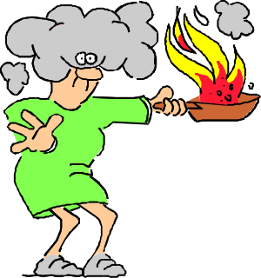

What’s It All About?
Algorithm:
  steps for the computer to follow to solve a problem
  well-defined computational procedure that transforms input into output
Some of our goals:
  recognize structure of some common problems
  understand important characteristics of algorithms to solve common problems
  select appropriate algorithm to solve a problem
  tailor existing algorithms
  create new algorithms

Slide 4


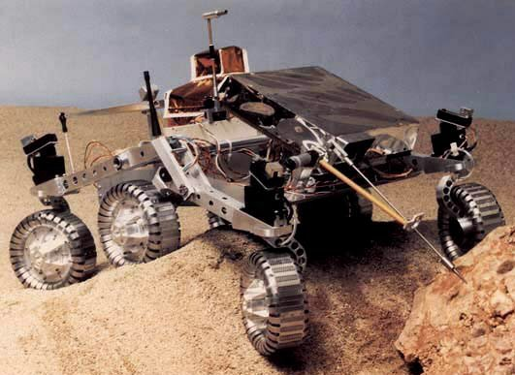
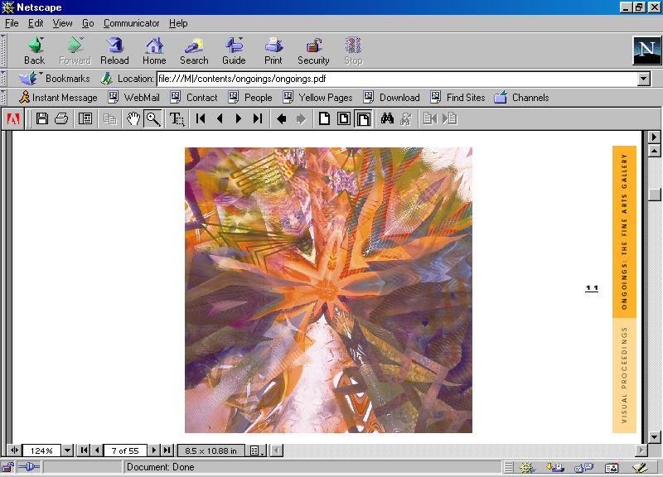
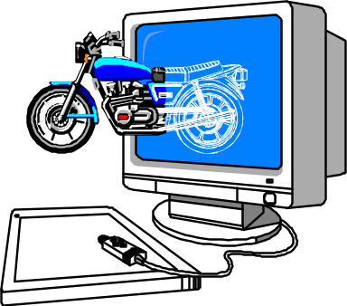
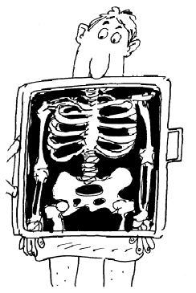

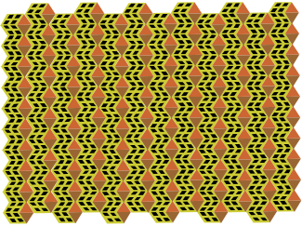
Some Algorithm Application Areas
Robotics
Bioinformatics
Telecommunications
Design
Analyze
Algorithms
Apply
Computer Graphics
Medical Imaging

Slide 5
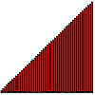
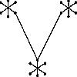
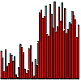
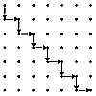
Some Typical Problems
Minimum Spanning Tree
  Input: Graph G = (V,E) with weighted edges
  Problem: Find subset of E of G of minimum weight which forms a tree on V
Shortest Path
  Input: Edge-weighted graph G , with start vertex s and end vertex t
  Problem: Find the shortest path from s to t in G
Sorting
  Input: Set of items
  Problem: Arrange items “in order”
Median finding
  Input: Set of numbers or keys
  Problem: Find item smaller than half of items and bigger than half of items
SOURCE: Steve Skiena’s Algorithm Design Manual
(for problem descriptions, see graphics gallery at http://www.cs.sunysb.edu/~algorith)

Slide 6
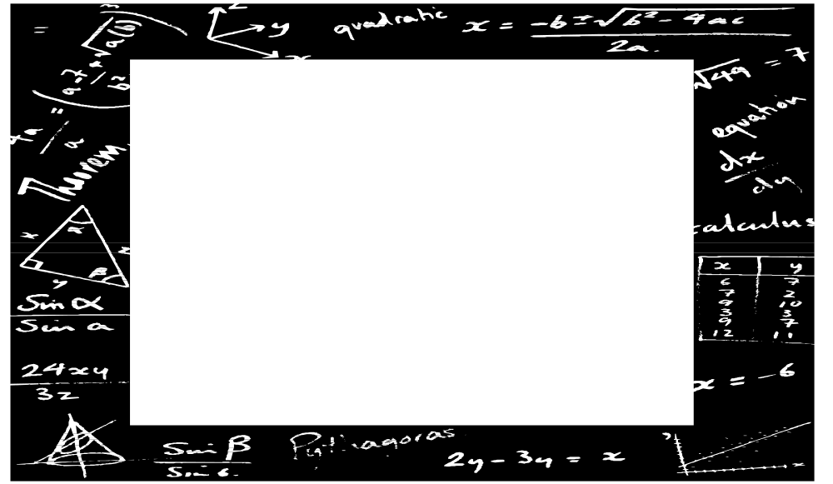
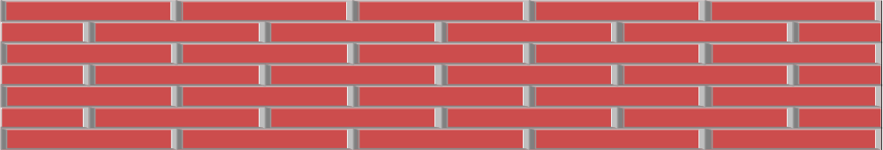
Tools of the Trade
Algorithm Design Patterns such as:
  divide-and-conquer
Data Structures such as:
  trees, linked lists, hash tables, graphs
Algorithm Analysis Techniques such as:
  asymptotic analysis
  probabilistic analysis
Summations
MATH
Permutations
Proofs
Combinations
Sets
Logarithms
Growth of Functions
Probability
Recurrences

Slide 7
Tools of the Trade: (continued) Algorithm Animation
http://vision.bc.edu/~dmartin/teaching/sorting/anim-html/all.html
http://www.cs.utah.edu/classes/cs2020-zachary/sorting.html
http://www.site.uottawa.ca/~stan/csi2514/applets/sort/sort.html
http://www.geocities.com/siliconvalley/network/1854/Sort1.html

Slide 8
What are we measuring?
Some Analysis Criteria:
  Scope
    The problem itself?
    A particular algorithm that solves the problem?
  “Dimension”
    Time Complexity? Space Complexity?
  Type of Bound
    Upper? Lower? Both?
  Type of Input
    Best-Case? Average-Case? Worst-Case?
  Type of Implementation
    Choice of Data Structure

Slide 9
Prerequisites
Computing I (91.101)
Computing II (91.102)
Discrete Math I & II (92.321, 92.322)
Statistics for Scientists and Engineers (92.386)
Calculus I-II (92.131-132)
Summations
MATH
Permutations
Proofs
Combinations
Sets
Logarithms
Growth of Functions
Probability
Recurrences

Slide 10
Course Structure: 5 Parts
Foundations
  Analyzing & Designing Algorithms, Growth of Functions, Recurrences, Probability & Randomized Algorithms
Sorting
  Heapsort, Priority Queues, Quicksort, Sorting in Linear Time
Data Structures
  Stacks and Queues, Linked Lists, Introduction to Trees, Hash Tables, Binary Search Trees, Balancing Trees: Red-Black Trees
Advanced Techniques
  Dynamic Programming, Greedy Algorithms
Graph Algorithms
  DFS, BFS, Topological Sort, MST, Shortest paths
Part 1
Part 2
Part 3
Part 4
Part 5

Slide 11

Textbook
Required:
  Introduction to Algorithms
    by T.H. Corman, C.E. Leiserson, R.L. Rivest
    McGraw-Hill
    2001
    ISBN 0-07-013151-1
    see course web site (MiscDocuments) for errata (1st edition)
2001 Edition
Ordered for UML bookstore

Slide 12
CS Theory Math Review Sheet
The Most Relevant Parts...
p. 1
  O, Θ, Ω definitions
  Series
  Combinations
p. 2 Recurrences & Master Method
p. 3
  Probability
  Factorial
  Logs
  Stirling’s approx
p. 4 Matrices
p. 5 Graph Theory
p. 6 Calculus
  Product, Quotient rules
  Integration, Differentiation
  Logs
p. 8 Finite Calculus
p. 9 Series
Math fact sheet (courtesy of Prof. Costello) is on our web site.

Slide 13
Grading
Homework 30%
Midterm (chapters 1-6, open book & notes) 30%
Discretionary (attendance, participation, quiz) 10%
Final Exam (cumulative, open book & notes) 30%

